Slide 1



Weather Forecast with
Machine Learning
Made by K.Yerassyl
Short-term Temperature and Humidity Forecasting with Machine Learning

Slide 2


Introduction
Weather Forecast with
Machine Learning
Weather forecasting is vital for daily planning and decision-making. This project focuses on developing a weather application to predict short-term temperature and humidity. By integrating real-time data from OpenWeatherMap API and machine learning models, the system delivers accurate and actionable weather information. The client application offers an intuitive interface to make weather predictions accessible to users.
Made by K.Yerassyl
Short-term Temperature and Humidity Forecasting with Machine Learning

Slide 3







System Architecture
Introduction
Weather Forecast with
Machine Learning
Weather forecasting is vital for daily planning and decision-making. This project focuses on developing a weather application to predict short-term temperature and humidity. By integrating real-time data from OpenWeatherMap API and machine learning models, the system delivers accurate and actionable weather information. The client application offers an intuitive interface to make weather predictions accessible to users.
Made by K.Yerassyl
Short-term Temperature and Humidity Forecasting with Machine Learning

Slide 4


Introduction
Weather forecasting is vital for daily planning and decision-making. This project focuses on developing a weather application to predict short-term temperature and humidity. By integrating real-time data from OpenWeatherMap API and machine learning models, the system delivers accurate and actionable weather information. The client application offers an intuitive interface to make weather predictions accessible to users.
System Architecture
Traditional methods of weather forecasting, like numerical weather prediction, rely on solving complex equations of atmospheric physics. Machine learning enhances this process by identifying patterns in historical data. Algorithms such as linear regression and LSTM networks are widely used for short-term forecasting. Real-time APIs, like OpenWeatherMap, have revolutionized access to weather data, enabling developers to build sophisticated applications.

Slide 5

Machine Learning Model
The project uses a Long Short-Term Memory (LSTM) neural network for short-term temperature and humidity forecasting. LSTM is ideal for time-series data, capturing patterns from historical weather observations.
Traditional methods of weather forecasting, like numerical weather prediction, rely on solving complex equations of atmospheric physics. Machine learning enhances this process by identifying patterns in historical data. Algorithms such as linear regression and LSTM networks are widely used for short-term forecasting. Real-time APIs, like OpenWeatherMap, have revolutionized access to weather data, enabling developers to build sophisticated applications.
Key Features:
Input features: Temperature, humidity, wind speed, and pressure.
Trained on preprocessed weather data from OpenWeatherMap.
Dataset split: 70% training, 20% validation, 10% testing.
Model Performance:
Mean Absolute Error (MAE): < 2°C for temperature, < 5% for humidity.
Loss function: Mean Squared Error (MSE).
The trained model is integrated into the application to provide accurate real-time predictions, enhancing the forecasting experience for users.
System Architecture

Slide 6
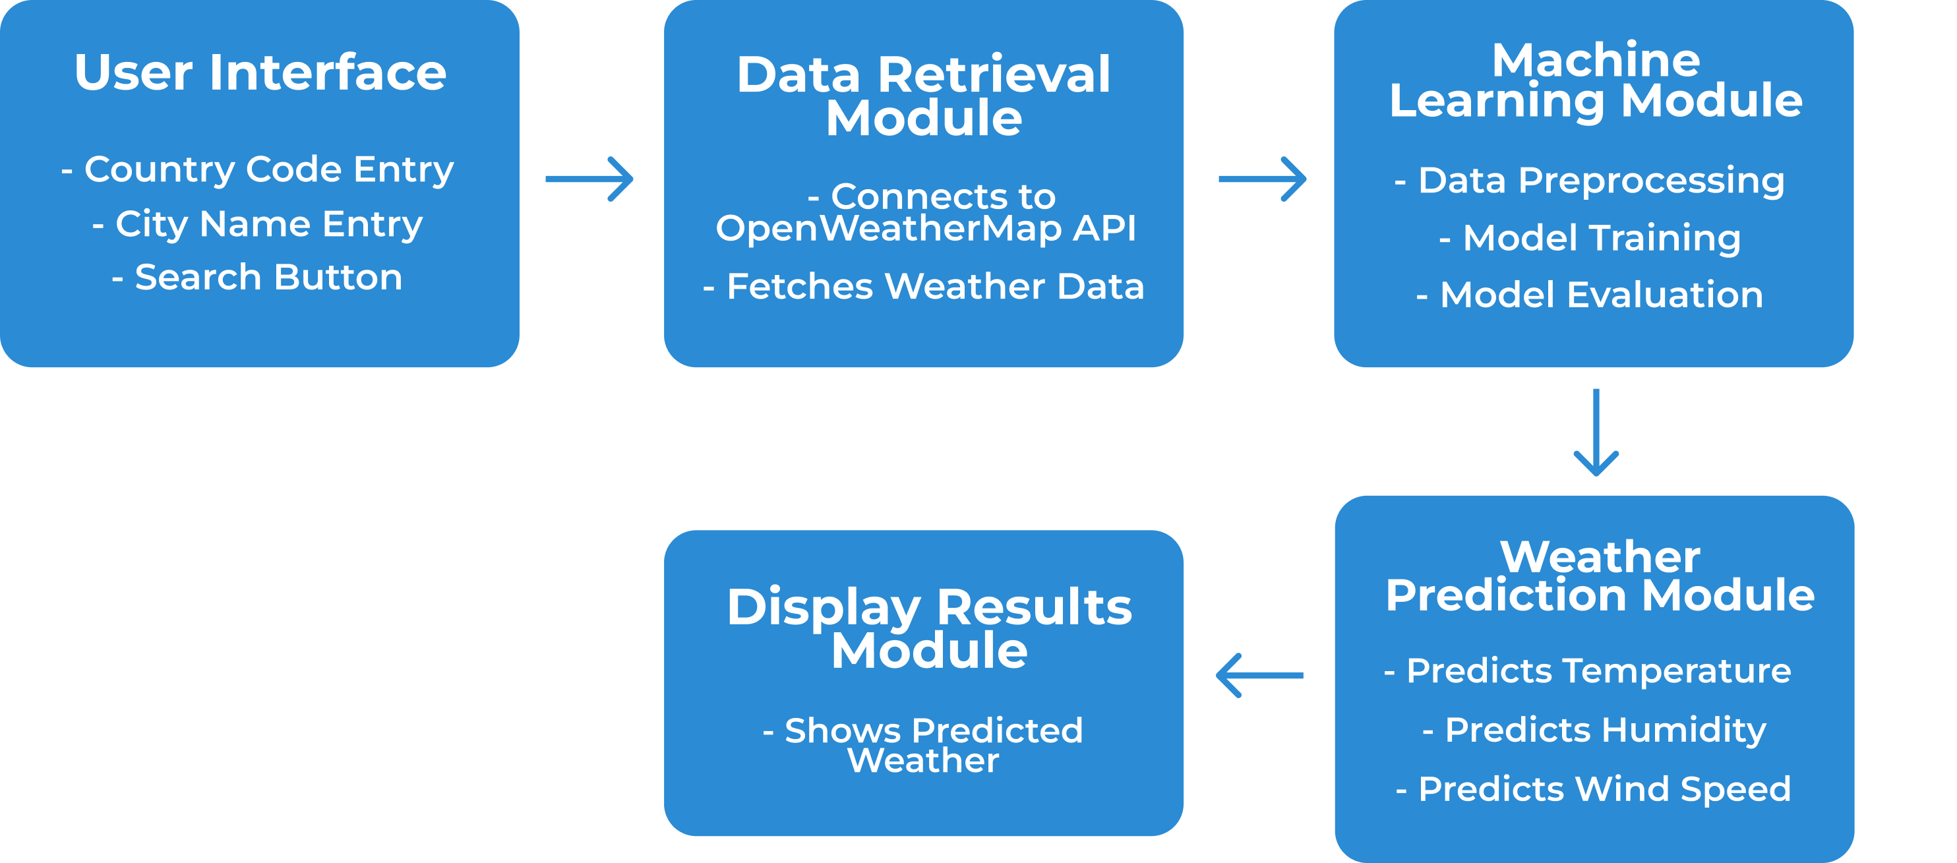
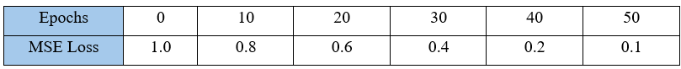


Classification Diagram
Traditional methods of weather forecasting, like numerical weather prediction, rely on solving complex equations of atmospheric physics. Machine learning enhances this process by identifying patterns in historical data. Algorithms such as linear regression and LSTM networks are widely used for short-term forecasting. Real-time APIs, like OpenWeatherMap, have revolutionized access to weather data, enabling developers to build sophisticated applications.
Dataset
Machine Learning Model
The project uses Long Short-Term Memory (LSTM), a type of Recurrent Neural Network (RNN), for short-term weather forecasting. LSTM is well-suited for handling time-series data, such as temperature and humidity, due to its ability to capture temporal dependencies.
The project utilizes data from the OpenWeatherMap API and integrates a database to enhance functionality. Together, they form the foundation for real-time forecasting and historical data management.
Dataset Features (from API):
Temperature (°C)
Humidity (%)
Wind Speed (m/s)
Pressure (hPa)
Weather Description (e.g., sunny, cloudy, rainy)
Database Integration:
The database stores past weather queries and results to reduce API dependency and improve performance.
Table structure WeatherData:
Fields: City, Country, Temperature, Humidity, Wind Speed, Timestamp, Weather Description.
Forget Gate: Determines which information to discard:
𝑓𝑡=𝜎(𝑊𝑓⋅[ℎ𝑡−1,𝑥𝑡]+𝑏𝑓)f t​ =σ(W f​ ⋅[h t−1​ ,x t​ ]+b f​ )
Input Gate: Updates the cell state with new information:
𝑖𝑡=𝜎(𝑊𝑖⋅[ℎ𝑡−1,𝑥𝑡]+𝑏𝑖) and 𝐶~𝑡=tanh⁡(𝑊𝐶⋅[ℎ𝑡−1,𝑥𝑡]+𝑏𝐶)
Cell State Update: Combines past and new information:
𝐶𝑡=𝑓𝑡⊙𝐶𝑡−1+𝑖𝑡⊙𝐶~𝑡
Output Gate: Decides the final output:
𝑜𝑡=𝜎(𝑊𝑜⋅[ℎ𝑡−1,𝑥𝑡]+𝑏𝑜) and ℎ𝑡=𝑜𝑡⊙tanh⁡(𝐶𝑡)
System Architecture

Slide 7
Classification Diagram
Traditional methods of weather forecasting, like numerical weather prediction, rely on solving complex equations of atmospheric physics. Machine learning enhances this process by identifying patterns in historical data. Algorithms such as linear regression and LSTM networks are widely used for short-term forecasting. Real-time APIs, like OpenWeatherMap, have revolutionized access to weather data, enabling developers to build sophisticated applications.
Machine Learning Model
Dataset
The project uses Long Short-Term Memory (LSTM), a type of Recurrent Neural Network (RNN), for short-term weather forecasting. LSTM is well-suited for handling time-series data, such as temperature and humidity, due to its ability to capture temporal dependencies.
The project utilizes data from the OpenWeatherMap API and integrates a database to enhance functionality. Together, they form the foundation for real-time forecasting and historical data management.
Dataset Features (from API):
Temperature (°C)
Humidity (%)
Wind Speed (m/s)
Pressure (hPa)
Weather Description (e.g., sunny, cloudy, rainy)
Database Integration:
The database stores past weather queries and results to reduce API dependency and improve performance.
Table structure WeatherData:
Fields: City, Country, Temperature, Humidity, Wind Speed, Timestamp, Weather Description.
Forget Gate: Determines which information to discard:
𝑓𝑡=𝜎(𝑊𝑓⋅[ℎ𝑡−1,𝑥𝑡]+𝑏𝑓)f t​ =σ(W f​ ⋅[h t−1​ ,x t​ ]+b f​ )
Input Gate: Updates the cell state with new information:
𝑖𝑡=𝜎(𝑊𝑖⋅[ℎ𝑡−1,𝑥𝑡]+𝑏𝑖) and 𝐶~𝑡=tanh⁡(𝑊𝐶⋅[ℎ𝑡−1,𝑥𝑡]+𝑏𝐶)
Cell State Update: Combines past and new information:
𝐶𝑡=𝑓𝑡⊙𝐶𝑡−1+𝑖𝑡⊙𝐶~𝑡
Output Gate: Decides the final output:
𝑜𝑡=𝜎(𝑊𝑜⋅[ℎ𝑡−1,𝑥𝑡]+𝑏𝑜) and ℎ𝑡=𝑜𝑡⊙tanh⁡(𝐶𝑡)
System Architecture

Slide 8

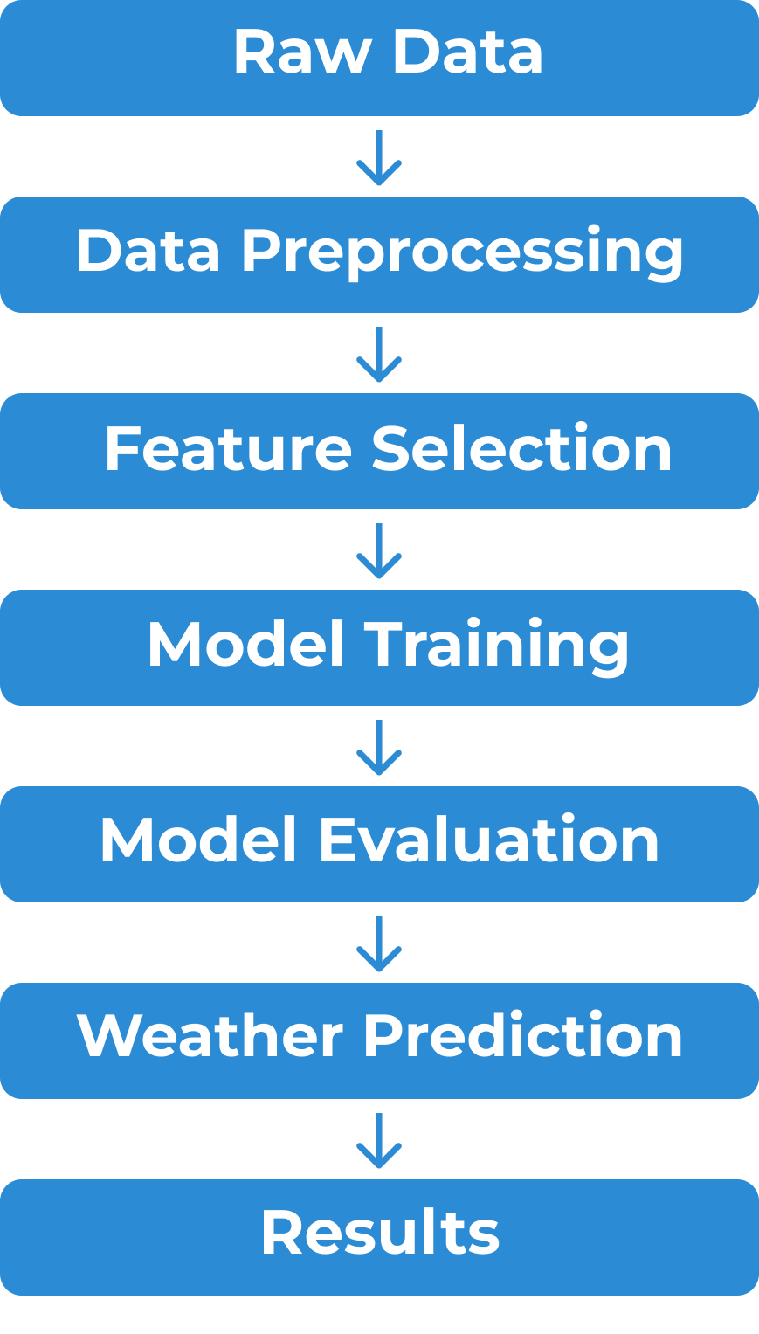
Traditional methods of weather forecasting, like numerical weather prediction, rely on solving complex equations of atmospheric physics. Machine learning enhances this process by identifying patterns in historical data. Algorithms such as linear regression and LSTM networks are widely used for short-term forecasting. Real-time APIs, like OpenWeatherMap, have revolutionized access to weather data, enabling developers to build sophisticated applications.
Classification Diagram
Machine Learning Model
The project uses a Long Short-Term Memory (LSTM) neural network for short-term temperature and humidity forecasting. LSTM is ideal for time-series data, capturing patterns from historical weather observations.
Flowchart
Key Features:
Input features: Temperature, humidity, wind speed, and pressure.
Trained on preprocessed weather data from OpenWeatherMap.
Dataset split: 70% training, 20% validation, 10% testing.
Model Performance:
Mean Absolute Error (MAE): < 2°C for temperature, < 5% for humidity.
Loss function: Mean Squared Error (MSE).
The trained model is integrated into the application to provide accurate real-time predictions, enhancing the forecasting experience for users.
Diagram
System Architecture

Slide 9
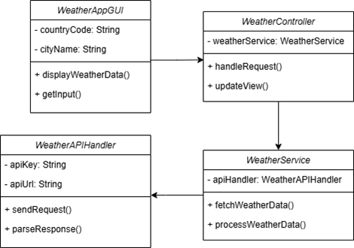
Traditional methods of weather forecasting, like numerical weather prediction, rely on solving complex equations of atmospheric physics. Machine learning enhances this process by identifying patterns in historical data. Algorithms such as linear regression and LSTM networks are widely used for short-term forecasting. Real-time APIs, like OpenWeatherMap, have revolutionized access to weather data, enabling developers to build sophisticated applications.
UML Diagram
Machine Learning Model
The project uses a Long Short-Term Memory (LSTM) neural network for short-term temperature and humidity forecasting. LSTM is ideal for time-series data, capturing patterns from historical weather observations.
Flowchart
Key Features:
Input features: Temperature, humidity, wind speed, and pressure.
Trained on preprocessed weather data from OpenWeatherMap.
Dataset split: 70% training, 20% validation, 10% testing.
Model Performance:
Mean Absolute Error (MAE): < 2°C for temperature, < 5% for humidity.
Loss function: Mean Squared Error (MSE).
The trained model is integrated into the application to provide accurate real-time predictions, enhancing the forecasting experience for users.
Diagram
System Architecture

Slide 10
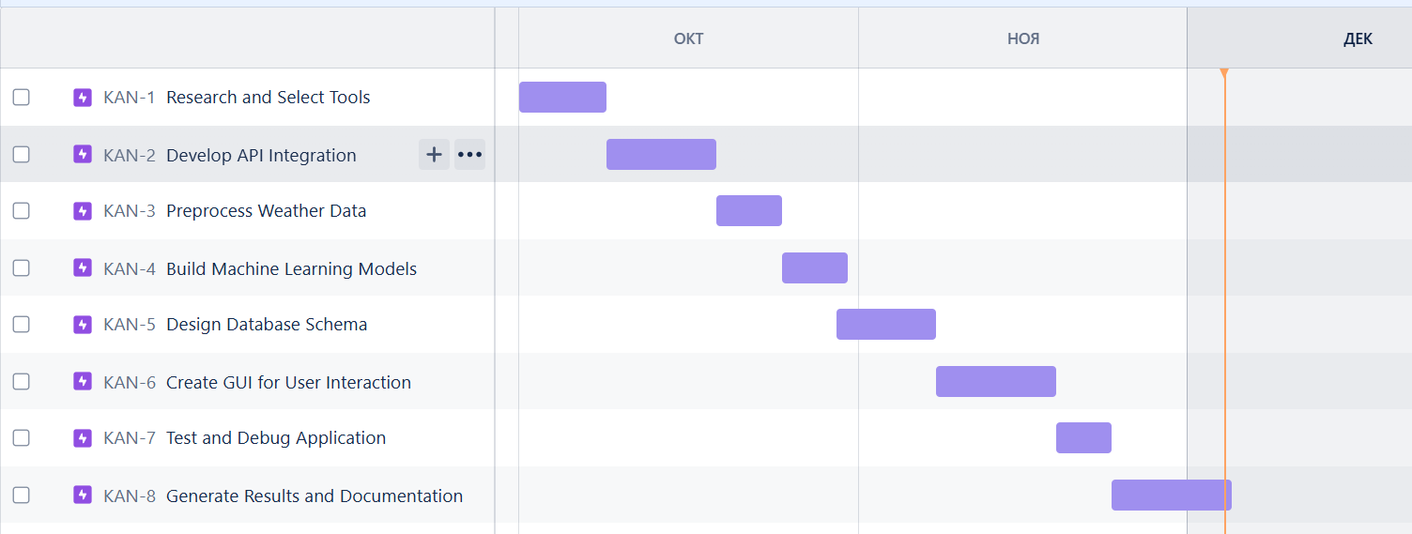
Traditional methods of weather forecasting, like numerical weather prediction, rely on solving complex equations of atmospheric physics. Machine learning enhances this process by identifying patterns in historical data. Algorithms such as linear regression and LSTM networks are widely used for short-term forecasting. Real-time APIs, like OpenWeatherMap, have revolutionized access to weather data, enabling developers to build sophisticated applications.
Jira Planning
Classification Diagram
Machine Learning Model
The project uses a Long Short-Term Memory (LSTM) neural network for short-term temperature and humidity forecasting. LSTM is ideal for time-series data, capturing patterns from historical weather observations.
Flowchart
Key Features:
Input features: Temperature, humidity, wind speed, and pressure.
Trained on preprocessed weather data from OpenWeatherMap.
Dataset split: 70% training, 20% validation, 10% testing.
Model Performance:
Mean Absolute Error (MAE): < 2°C for temperature, < 5% for humidity.
Loss function: Mean Squared Error (MSE).
The trained model is integrated into the application to provide accurate real-time predictions, enhancing the forecasting experience for users.
Diagram
System Architecture

Slide 11

Traditional methods of weather forecasting, like numerical weather prediction, rely on solving complex equations of atmospheric physics. Machine learning enhances this process by identifying patterns in historical data. Algorithms such as linear regression and LSTM networks are widely used for short-term forecasting. Real-time APIs, like OpenWeatherMap, have revolutionized access to weather data, enabling developers to build sophisticated applications.
Jira Planning
Classification Diagram
Machine Learning Model
The project uses a Long Short-Term Memory (LSTM) neural network for short-term temperature and humidity forecasting. LSTM is ideal for time-series data, capturing patterns from historical weather observations.
Flowchart
Key Features:
Input features: Temperature, humidity, wind speed, and pressure.
Trained on preprocessed weather data from OpenWeatherMap.
Dataset split: 70% training, 20% validation, 10% testing.
Model Performance:
Mean Absolute Error (MAE): < 2°C for temperature, < 5% for humidity.
Loss function: Mean Squared Error (MSE).
The trained model is integrated into the application to provide accurate real-time predictions, enhancing the forecasting experience for users.
Diagram
System Architecture
Client Application
The client application is a Java-based desktop program developed using Swing for a user-friendly graphical interface. It enables users to input location details and retrieve real-time weather data alongside predictions.
Key Features:
Input fields for city and country code.
Dynamic display of temperature, humidity, wind speed, and weather conditions.
Integration of machine learning predictions for short-term forecasts.
Error handling for invalid inputs and connectivity issues.
The intuitive design ensures easy navigation, making weather forecasting accessible to all users. Future upgrades may include interactive charts and multi-language support.

Slide 12

Jira Planning
Traditional methods of weather forecasting, like numerical weather prediction, rely on solving complex equations of atmospheric physics. Machine learning enhances this process by identifying patterns in historical data. Algorithms such as linear regression and LSTM networks are widely used for short-term forecasting. Real-time APIs, like OpenWeatherMap, have revolutionized access to weather data, enabling developers to build sophisticated applications.
Conclusion
Classification Diagram
Client Application
Machine Learning
Machine Learning Model
Conclusion
The project uses a Long Short-Term Memory (LSTM) neural network for short-term temperature and humidity forecasting. LSTM is ideal for time-series data, capturing patterns from historical weather observations.
The project uses Long Short-Term Memory (LSTM), a type of Recurrent Neural Network (RNN), for short-term weather forecasting. LSTM is well-suited for handling time-series data, such as temperature and humidity, due to its ability to capture temporal dependencies.
The client application is a Java-based desktop program developed using Swing for a user-friendly graphical interface. It enables users to input location details and retrieve real-time weather data alongside predictions.
Key Features:
Input fields for city and country code.
Dynamic display of temperature, humidity, wind speed, and weather conditions.
Integration of machine learning predictions for short-term forecasts.
Error handling for invalid inputs and connectivity issues.
The intuitive design ensures easy navigation, making weather forecasting accessible to all users. Future upgrades may include interactive charts and multi-language support.
Flowchart
The project successfully integrated real-time data retrieval, machine learning models, and a user-friendly interface. It highlights the potential of machine learning in weather forecasting. Future iterations could focus on improving model performance, incorporating additional features, and scaling the application for broader usage.
Key Features:
Input features: Temperature, humidity, wind speed, and pressure.
Trained on preprocessed weather data from OpenWeatherMap.
Dataset split: 70% training, 20% validation, 10% testing.
Model Performance:
Mean Absolute Error (MAE): < 2°C for temperature, < 5% for humidity.
Loss function: Mean Squared Error (MSE).
The trained model is integrated into the application to provide accurate real-time predictions, enhancing the forecasting experience for users.
The project successfully integrated real-time data retrieval, machine learning models, and a user-friendly interface. It highlights the potential of machine learning in weather forecasting. Future iterations could focus on improving model performance, incorporating additional features, and scaling the application for broader usage.
Diagram
Forget Gate: Determines which information to discard:
𝑓𝑡=𝜎(𝑊𝑓⋅[ℎ𝑡−1,𝑥𝑡]+𝑏𝑓)f t​ =σ(W f​ ⋅[h t−1​ ,x t​ ]+b f​ )
Input Gate: Updates the cell state with new information:
𝑖𝑡=𝜎(𝑊𝑖⋅[ℎ𝑡−1,𝑥𝑡]+𝑏𝑖) and 𝐶~𝑡=tanh⁡(𝑊𝐶⋅[ℎ𝑡−1,𝑥𝑡]+𝑏𝐶)
Cell State Update: Combines past and new information:
𝐶𝑡=𝑓𝑡⊙𝐶𝑡−1+𝑖𝑡⊙𝐶~𝑡
Output Gate: Decides the final output:
𝑜𝑡=𝜎(𝑊𝑜⋅[ℎ𝑡−1,𝑥𝑡]+𝑏𝑜) and ℎ𝑡=𝑜𝑡⊙tanh⁡(𝐶𝑡)
System Architecture

Slide 13

Jira Planning
Traditional methods of weather forecasting, like numerical weather prediction, rely on solving complex equations of atmospheric physics. Machine learning enhances this process by identifying patterns in historical data. Algorithms such as linear regression and LSTM networks are widely used for short-term forecasting. Real-time APIs, like OpenWeatherMap, have revolutionized access to weather data, enabling developers to build sophisticated applications.
Classification Diagram
Client Application
Machine Learning Model
Conclusion
The project uses a Long Short-Term Memory (LSTM) neural network for short-term temperature and humidity forecasting. LSTM is ideal for time-series data, capturing patterns from historical weather observations.
The client application is a Java-based desktop program developed using Swing for a user-friendly graphical interface. It enables users to input location details and retrieve real-time weather data alongside predictions.
Key Features:
Input fields for city and country code.
Dynamic display of temperature, humidity, wind speed, and weather conditions.
Integration of machine learning predictions for short-term forecasts.
Error handling for invalid inputs and connectivity issues.
The intuitive design ensures easy navigation, making weather forecasting accessible to all users. Future upgrades may include interactive charts and multi-language support.
Flowchart
The project successfully integrated real-time data retrieval, machine learning models, and a user-friendly interface. It highlights the potential of machine learning in weather forecasting. Future iterations could focus on improving model performance, incorporating additional features, and scaling the application for broader usage.
Key Features:
Input features: Temperature, humidity, wind speed, and pressure.
Trained on preprocessed weather data from OpenWeatherMap.
Dataset split: 70% training, 20% validation, 10% testing.
Model Performance:
Mean Absolute Error (MAE): < 2°C for temperature, < 5% for humidity.
Loss function: Mean Squared Error (MSE).
The trained model is integrated into the application to provide accurate real-time predictions, enhancing the forecasting experience for users.
Diagram
System Architecture

Slide 14
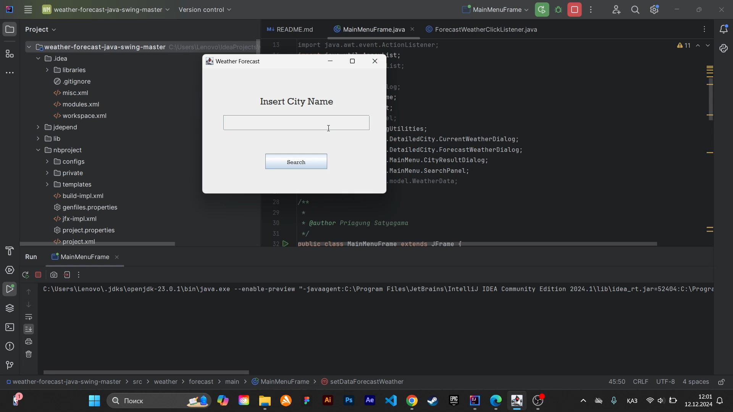
Jira Planning
Traditional methods of weather forecasting, like numerical weather prediction, rely on solving complex equations of atmospheric physics. Machine learning enhances this process by identifying patterns in historical data. Algorithms such as linear regression and LSTM networks are widely used for short-term forecasting. Real-time APIs, like OpenWeatherMap, have revolutionized access to weather data, enabling developers to build sophisticated applications.
Classification Diagram
Client Application
Machine Learning Model
Conclusion
The project uses a Long Short-Term Memory (LSTM) neural network for short-term temperature and humidity forecasting. LSTM is ideal for time-series data, capturing patterns from historical weather observations.
The client application is a Java-based desktop program developed using Swing for a user-friendly graphical interface. It enables users to input location details and retrieve real-time weather data alongside predictions.
Key Features:
Input fields for city and country code.
Dynamic display of temperature, humidity, wind speed, and weather conditions.
Integration of machine learning predictions for short-term forecasts.
Error handling for invalid inputs and connectivity issues.
The intuitive design ensures easy navigation, making weather forecasting accessible to all users. Future upgrades may include interactive charts and multi-language support.
Flowchart
The project successfully integrated real-time data retrieval, machine learning models, and a user-friendly interface. It highlights the potential of machine learning in weather forecasting. Future iterations could focus on improving model performance, incorporating additional features, and scaling the application for broader usage.
Key Features:
Input features: Temperature, humidity, wind speed, and pressure.
Trained on preprocessed weather data from OpenWeatherMap.
Dataset split: 70% training, 20% validation, 10% testing.
Model Performance:
Mean Absolute Error (MAE): < 2°C for temperature, < 5% for humidity.
Loss function: Mean Squared Error (MSE).
The trained model is integrated into the application to provide accurate real-time predictions, enhancing the forecasting experience for users.
Diagram
System Architecture

